Slide 1
Intro to ReactJS

Slide 2
What is React ?
Library for building User Interfaces
V part of MVC ( Model View Controller )
Not a front end Framework
React is not a Templating Library

Slide 3
Why To Use React ?
Simple
Declarative
Build Reusable Components

Slide 4
FIELD | REACT.JS | ANGULAR
Used as | React js is a JavaScript library. As it indicates react js updates only the virtual DOM present and the data flow is always in a single direction. | Angular is a framework. Angular updates the Real DOM and the data flow is ensured on both the directions.
Architecture | React js is more simplified as it follows MVC- Model View Control. This like angular includes features such as navigation but this can be achieved only with certain libraries like Redux and Flux.Needs more configuration and integration. | Architecture of angular on the other hand is a bit complex as it follows MVVM models- Model View View Model. This includes lots of tools and other features required for navigation, routing and various other functionalities.
Performance | React js holds JSX hence the usage of html codes and syntax is enabled. But this doesn’t make react js a subset of html. This is purely JavaScript based. | Angular on the other is a mere subset of html.
Preference : | React js is preferred when the dynamic content needed is intensive. As react js holds more of a straightforward programming and since it is reliable many apps such as Instagram, Facebook and Twitter still prefer to react js over angular. | Angular is platform-independent and hence is compatible to work in any platform. Hence app which is compatible with all the browsers can prefer angular. One major app which uses angular is Youtube.

Slide 5
React Uses JSX (JavaScript & XML)
Standard HTML - Accept all attributes
Little modifications like className instead of class
var CommentBox = React.createClass( {
render: function() {
return ( Hello, world! I am a CommentBox.);
}
});

Slide 6
Virtual DOM
React uses a concept called Virtual DOM
It’s Faster for re-rendering the entire component on every state change.
Virtual DOM uses diff algorithm.
Can rendered in server and synced with local client.

Slide 7
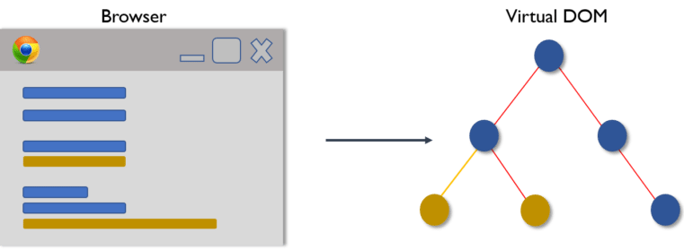
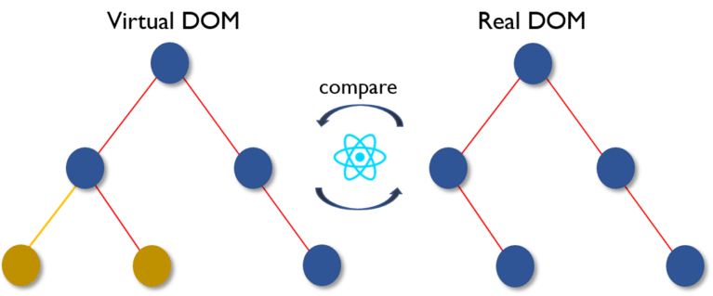
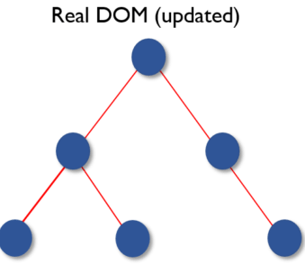

Slide 8
Three Important Terminologies
Components
States
Props

Slide 9
Components
Everything is a component in react
Created using React.createClass
Key functions for every components
getInitialState: function() {},
componentWillMount : function() {}, componentDidMount : function() {}, componentWillUnmount : function() {}, componentDidUnmount : function() {},
render : function() {}

Slide 10
States
Defines states of a component.
Changes to the state causes re rendering of the entire component.
getInitialState() is used to set initial states of the component
setState({state: value}) is used to update the state

Slide 11
Props
Loaded as attributes for components
Used for unidirectional data flow
immutable or read only
var CommentBox = React.createClass({
render: function() {
return ( {this.props.message} );
}
}); ReactDOM.render(,document.getElementById('content'));

Slide 12
Render Function
The Actual View Code is written here
States and Props both are read-only here
Returns JSX Elements
render: function() {
return (
{this.props.message}
);
}

Slide 13
Forms
Form elements are pointed or named with ref attribute
From values are extracted like this.refs.searchInput.value where searchInput is the ref of the input element
Default value is set with help of defaultValue attribute

Slide 14
Events
Cross Browser Events
CamelCase Event Handlers
onClick onDragStart
onContextMenu onDrop
onDoubleClick onMouseDown
onDrag onMouseEnter
onDragEnd onMouseLeave
onDragEnter onMouseMove
onDragExit onMouseOut
onDragLeave onMouseOver
onDragOver onMouseUp

Slide 15
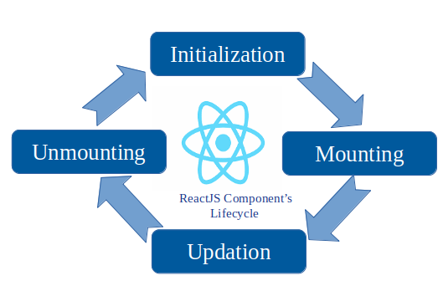
Component LifeCycle

Slide 16
Sites built with React
Facebook
Whatsapp Web
Netflix
BlankCursor
Instagram
Producthunt
messenger.com

Slide 17
Any Questions?

Slide 18
Thank You !

